Slide 1
Econ 100 Principles of Economics
Lecture 10
March 29

Slide 2
TODAY
Demand (cont’d)
Supply
Several in-class exercises
Assignment 3

Slide 3


Slide 4
Demand
The demand curve gives the relationship between price and quantity demanded, assuming that all other determinants of quantity demanded are kept constant.
The Law of Demand: Other things being equal, the quantity demanded of a good rises when the price of the good falls.
Remark: A change in the price of a good will cause a change in the quantity demanded of that good, but will not cause a change in the demand for that good.

Slide 5
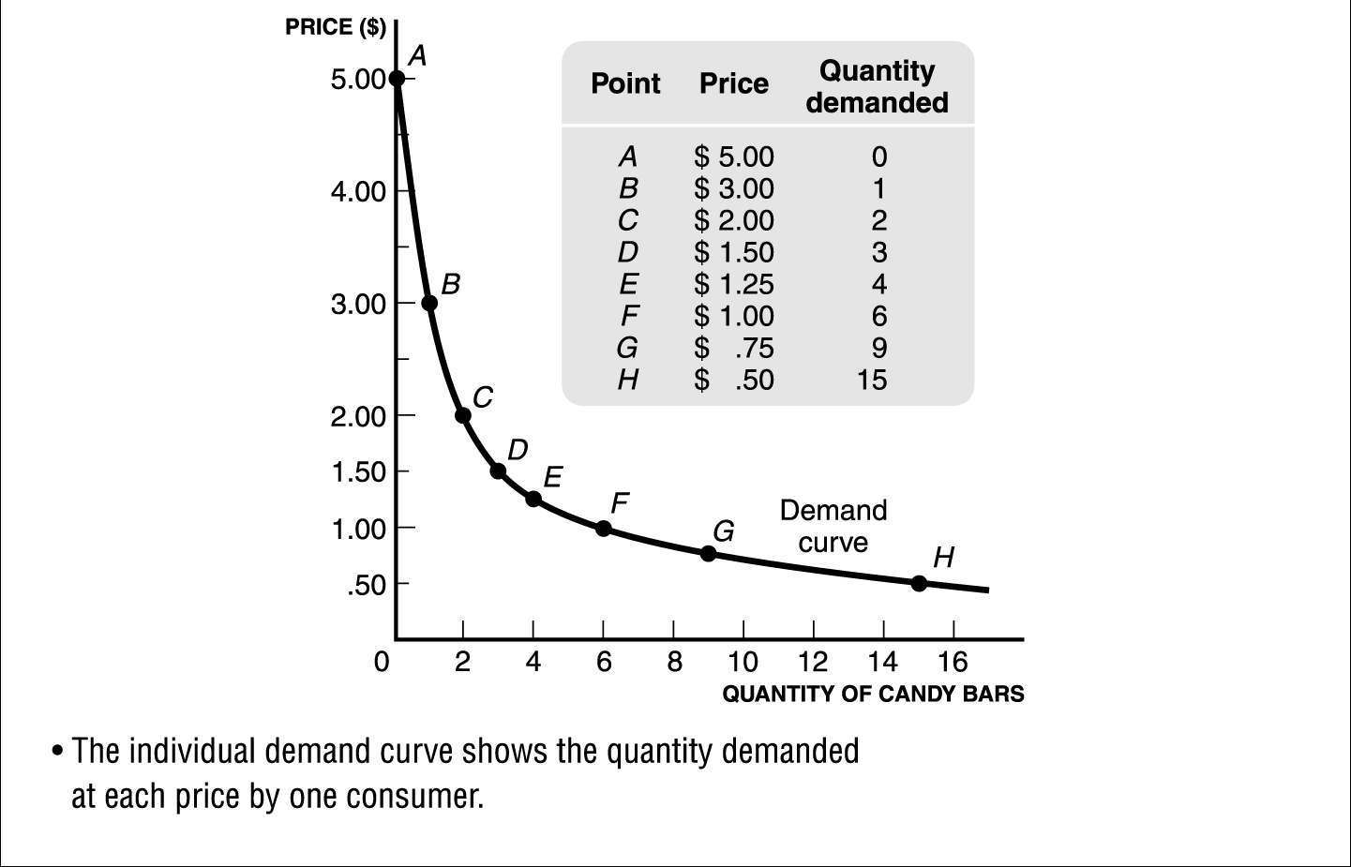
Demand
The individual demand curve shows the quantity demanded at each price by one consumer.

Slide 6
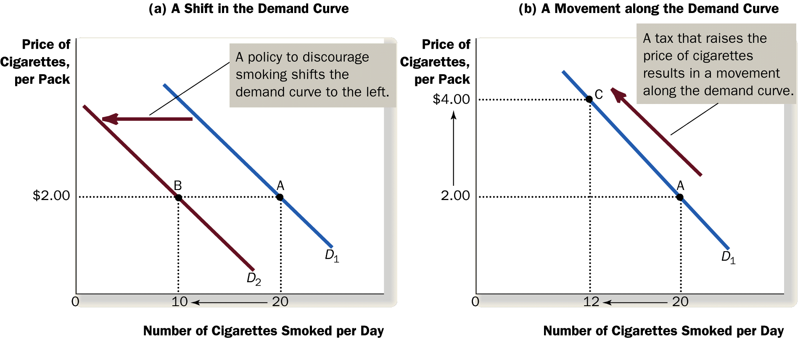
Demand
A change in the price of a good will cause a change in the quantity demanded of that good, but will not cause a change in the demand for that good.

Slide 7
Shifts in the Demand Curve
Consumer Income
As income increases, the demand for a normal good will increase.
As income increases, the demand for an inferior good will decrease.
Normal Good: e.g. meat
Inferior Good: e.g. bread
P
P
-
$3.00
An increase
$3.00
2.50
in income...
2.50
An increase
2.00
Increase
2.00
in income...
in demand
1.50
1.50
Decrease
in demand
1.00
1.00
0.50
D
2
0.50
D
1
D
2
D
1
Q
0
1
2
3
4
5
6
7
8
9
10
11
12
Q
0
1
2
3
4
5
6
7
8
9
10
11
12
-

Slide 8
Shifts in the Demand Curve
Prices of Related Goods
When a fall in the price of good X reduces the demand for good Y, these two goods X and Y are called substitutes.
Example: Ipad and labtop are substitutes. Suppose the price of Ipad decreases.
Tablet market
P
Labtop market
P
-
$3.00
$3.00
2.50
2.50
A
2.00
2.00
1.50
Decrease
1.50
in demand
1.00
1.00
B
0.50
0.50
D
1
D
2
D
1
-
0
1
2
3
4
5
6
7
8
9
10
11
12
Q
0
1
2
3
4
5
6
7
8
9
10
11
12
Q

Slide 9
Shifts in the Demand Curve
Prices of Related Goods
When a fall in the price of good X increases the demand for good Y, these two goods X and Y are called complements.
Example: DVD and DVD player are complements. Suppose the price of DVD’s decreases.
DVD market
DVD player market
P
-
P
$300
$30
250
25
A
200
22
150
Increase
15
in demand
10
100
B
5
50
D
1
D
2
D
1
-
0
1
2
3
4
5
6
7
8
9
10
11
12
Q
0
1
2
3
4
5
6
7
8
9
10
11
12
Q

Slide 10
Question #1: What is the effect of these events on the demand for small cars?
Small cars become more fashionable.
The price of large cars rises (the price of small ones is the same).
Income declines (small cars are an inferior good).
A big decrease in the price of gasoline.

Slide 11
A very typical exercise on demand
Draw the market demand curve for running shoes. (Do not bother with specific numbers, just draw a demand curve using the price and quantity axes.)
Choose a price (say P^{O}) and label the quantity demanded (Q₁) at that price.
Draw a new demand curve that shows a smaller quantity demanded (Q₂) at price P^{O}.
Give three reasons that could account for this decrease in demand.

Slide 12
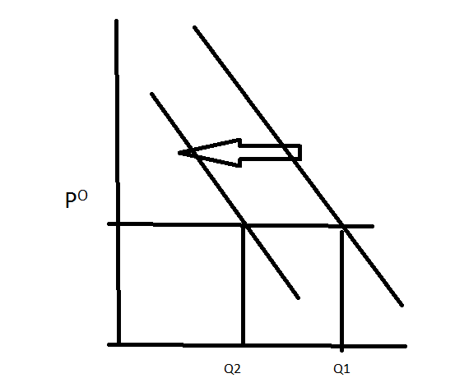
Typical answer
Income
Price
Taste
PRICE
QUANTITY
Q2 Q1

Slide 13
Demand for running shoes
Price of running shoes
An decrease in income (running shoes are a normal good.)
Studies find that running more than 10km per week is bad for health.
Number of public swimming pools (free) increase, health clubs with swimming pools offer big discounts.
decrease
in demand
P^{O}
D₁
D₂
Quantity demanded
Q₂
Q₁

Slide 14
Summary
The demand curve shows how the quantity of a good depends upon the price.
According to the law of demand, as the price of a good falls (rises), the quantity demanded rises (falls). Therefore, the demand curve slopes downward.
Other determinants of how much consumers want to buy are: income, the prices of complements and substitutes, tastes, expectations, and the number of buyers.
If one of these factors changes, the demand curve shifts.

Slide 15
Summary
Normal goods: As income increases demand increases; as income decreases demand decreases.
Inferior goods: As income increases, demand decreases. As income decreases demand increases.
Demand for a good will increase if the price of the complement good falls. (cars - gasoline)
Demand for a good will decrease if the price of the substitute good falls. (butter - margarine)

Slide 16
Question #2: Which of the following is least likely to increase the demand for coffee on campus?
a. A new scientific study finds that regular consumption of caffeinated beverages (like coffee) cures skin disorders.
b. Because of a price war (between Nero and Kahvehane) a medium size cup of coffee is now selling for 25 kuruş.
c. Nero starts giving away free cookies to their customers who buy coffee.
d. The price of a substitute, tea, rises.
e. There is a 25% increase in the student population.

Slide 17

Question #3: Please complete the table so that 1. good X is a normal good for Zeynep, and 2. Zeynep’s demand satisfies the “law of demand,” Please explain your reasoning.
 | Income
price | 120 | 80
3 | 16 | ?
4 | ? | 4

Slide 18
This concludes our discussion of demand.
Now, we turn to SUPPLY.

Slide 19
Introduction
Supply is the relationship between two variables: price and quantity supplied.
Supply can not be expressed as a single number
Quantity supplied is the amount of a good that sellers are willing and able to provide/bring to the market for sale.
Notes:
25

Slide 20
What determines the quantity supplied?
People sell things because it is a way, indirect but effective, of obtaining other things that they want.
Sellers want to make a profit from their sales, economics assumes they want their profits to be as large as possible.
Profit is revenues minus costs, therefore anything that influences revenues or costs can influence the amounts sellers want to sell.

Slide 21

What determines the quantity supplied?
Anything that influences revenues or
costs will influence the amounts
sellers want to sell.
We already saw an example:
Some farmers grow rice in southern
California, which is almost a desert.
Rice grows in paddies that the
farmers flood with water from huge
irrigation canals.
Why do they do that?

Slide 22
Because farmers can get water at low prices: they pay one fifth of the true cost of irrigating their crops; the rest is subsidized—paid for by the government. Water is thus relatively inexpensive for farmers.
Rice fetches a higher price in the market than other crops.
Rice brings more profit than other crops.

Slide 23
Supply
Supply is a relationship between two specific variables: Price and quantity supplied
while a number of other relevant variables are kept constant, e.g.
Input prices
Technology
Expectations
Quantity supplied of a good is the amount of that good that sellers are willing and able to sell.

Slide 24
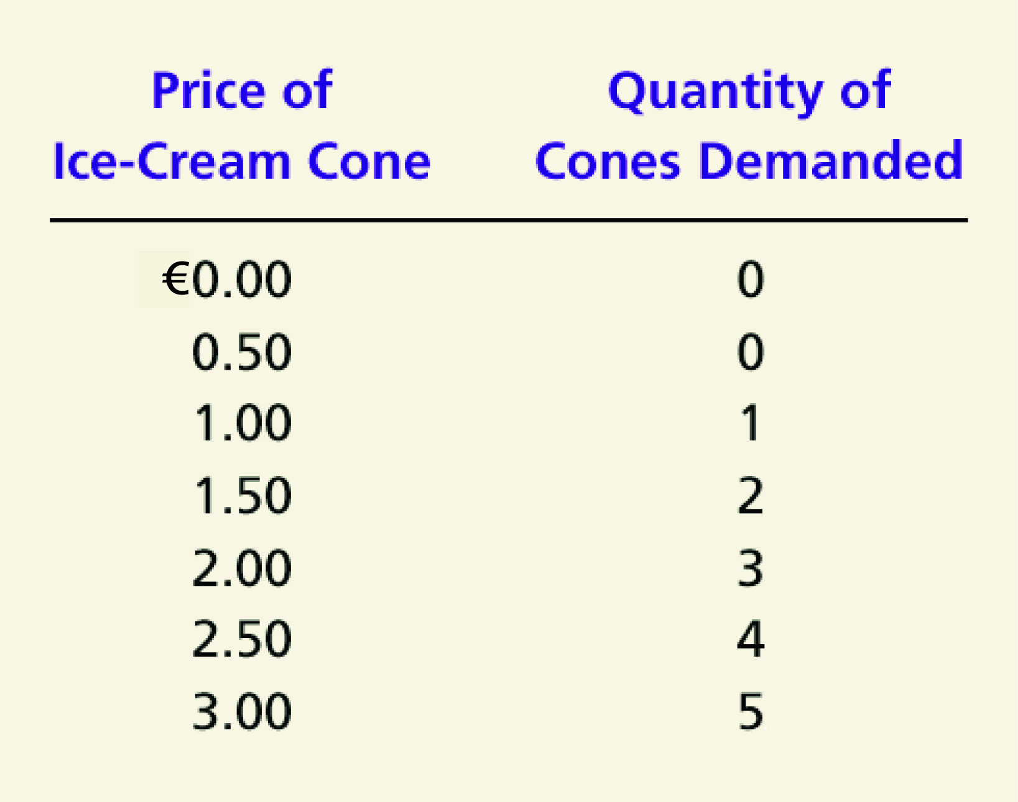
Supply Schedule Dondurmacı Veli
Supplied
Notes:
29

Slide 25
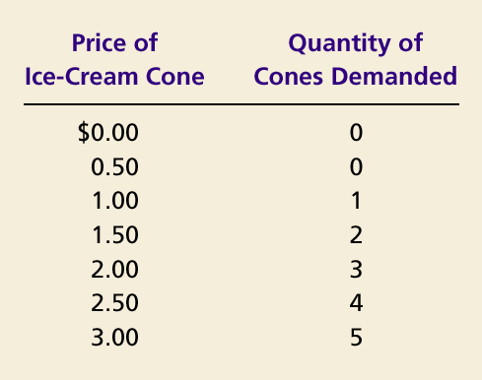
Dondurmacı Veli Usta’s Supply Schedule and Supply Curve
Price of
Ice-Cream
Cone
Supplied
$3.00
2.50
2.00
1.50
1.00
0.50
0
1
2
4
5
6
7
8
9
10
11
12
Quantity of
Ice-Cream Cones

Slide 26
Supply
The supply curve gives the relationship between price and quantity supplied, assuming that all other determinants of quantity supplied are kept constant.
The Law of Supply: Other things being equal, the quantity supplied of a good rises when the price of the good rises.
Remark: A change in the price of a good will cause a change in the quantity supplied of that good, but will not cause a change in the supply for that good.

Slide 27
Defending the law of supply
Revenue is the unit price of the product multiplied by the amount sold. (If you sell 5 units at a unit price of $3, your revenue will be $15.)
A change in price changes revenues and hence profits, so it is a major determinant of the amount sellers will want to sell.
Because a higher price leads to higher profit, and a higher profit leads to a larger amount that sellers will want to sell, we expect that a greater quantity is supplied when the price is higher.
Thus, the relationship between quantity that sellers will sell and price should be direct or positive.

Slide 28
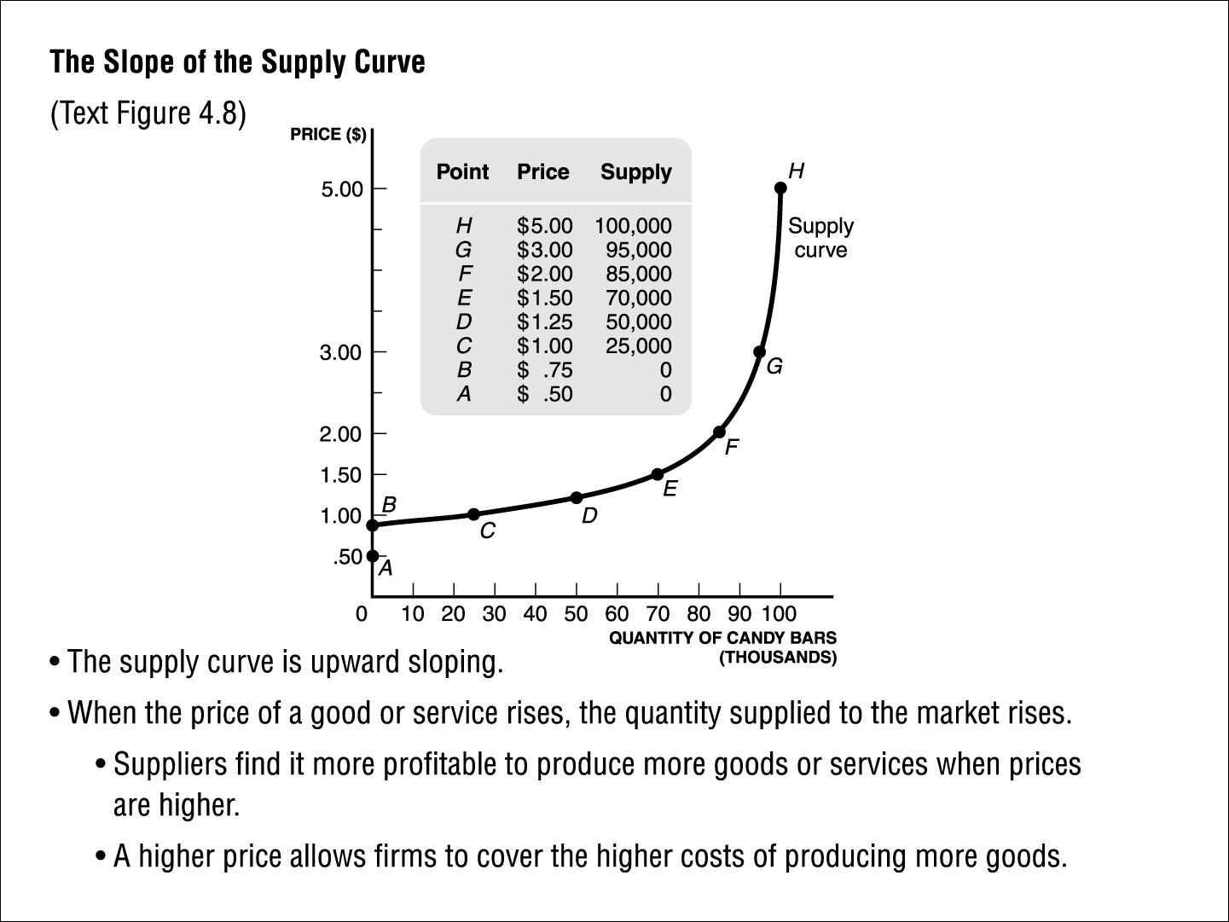
The Law of Supply

Slide 29
Change in Quantity Supplied
Price of Ice-Cream Cones
S
C
3.00
A rise in the price of ice cream cones results in a movement along the supply curve.
A
1.00
Quantity of Ice-Cream Cones
0
1
5
Notes:
30

Slide 30
Shifts in a Supply Curve versus Movements along a Supply Curve
A change in price is represented by a movement along the supply curve.
All other changes that affect supply shift the supply curve.
A change in the price of inputs
A change in technology
A change in the natural environment
A change in the availability of credit
A change in expectations

Slide 31

Sources of Shifts in Supply Curves
A rise in the price of coffee beans increases the costs of making espresso.
The supply of espresso decreases, i.e. the supply curve for espresso shifts left or up.
Espresso Market
Price
Decrease
Decrease
in supply
in supply
0
Quantity supplied
Copyright©2003 Southwestern/Thomson Learning

Slide 32
Sources of Shifts in Supply Curves
If a new technology improves coffee bean harvesting, the costs of producing espresso fall.
This increases the suppliers’ desire to sell at each price.
The supply increases, i.e. the supply curve shifts right.
Espresso Market
Price
Decrease
Increase
in supply
in supply
0
Quantity supplied
Copyright©2003 Southwestern/Thomson Learning

Slide 33
Example: Finding the supply curve
A small t-shirt factory uses one machine (leased at £20 a week) to produce t-shirts. The machine is operated by one worker and produces 1 t-shirt per hour.
The worker is paid £1 per hour on weekdays, £2 per hour on Saturdays , and £3 per hour on Sundays. Working day is max 8 hours by law. (strictly enforced.)
All other costs, such as raw materials, electricity, etc., are £1 per t-shirt.

Slide 34
Question #4
How many t-shirts will be supplied if Benetton pays £2.5 per t-shirt? _______
How many t-shirts if Benetton pays P = £3.5? _________
How many t-shirts if Benetton pays P = £4.5? _________
How many t-shirts if Benetton pays P = £1.5? _________
How many t-shirts if Benetton pays P = £2.5? _________
Use your answers to prepare the supply schedule. Put these price and quantity supplied figures in a table form with 2 columns. Also draw a price - quantity supplied graph, put these price and quantity supplied figures on the graph and connect the dots with a line. What is the shape of the line?

Slide 35
A small t-shirt factory uses one machine (leased at £20 a week) to produce t-shirts. The machine is operated by one worker and produces 1 t-shirt per hour.
The worker is paid £1 per hour on weekdays, £2 per hour on Saturdays , and £3 per hour on Sundays. Working day is max 8 hours by law. (strictly enforced.)
All other costs, such as raw materials, electricity, etc., are £1 per t-shirt.
Question #4:
How many t-shirts will be supplied if Benetton pays £2.5 per t-shirt? _______
How many t-shirts if Benetton pays P = £3.5? _________
How many t-shirts if Benetton pays P = £4.5? _________
How many t-shirts if Benetton pays P = £1.5? _________
How many t-shirts if Benetton pays P = £2.5? _________
Use your answers to prepare the supply schedule. Put these price and quantity supplied figures in a table form with 2 columns. Also draw a price - quantity supplied graph, put these price and quantity supplied figures on the graph and connect the dots with a line. What is the shape of the line?

